Slide 1


K.RAMAKRISHNAN COLLEGE OF TECHNOLOGY
(AUTONOMOUS), TRICHY.
SMART TRAFFIC MANAGEMENT SYSTEM
PRESENTED
NARENDRAN S
2303811710421102
SUPERVISOR
Mrs.K.Valli Priyadharshini M.E., (PhD),
AP/CSE.

Slide 2
PRESENTATION OVERVIEW
Objective
Project Introduction
Problem Statement
Methodologies (Programming concepts relevant to problem statement)
Architecture of the proposed system
List of Modules
Merits
Results and Discussion
Queries

Slide 3
OBJECTIVE
A smart traffic management system aims to revolutionize urban transportation by leveraging advanced technologies such as IoT, AI, and data analytics.
Its primary objectives include reducing traffic congestion through real-time adjustments to traffic signals and vehicle flow, enhancing road safety by quickly detecting accidents or hazards, and optimizing overall traffic flow to minimize delays.

Slide 4
PROJECT INTRODUCTION
The Smart Traffic Management System project aims to develop an intelligent transportation infrastructure that uses advanced technologies to improve the efficiency, safety, and sustainability of urban traffic.
Traditional traffic management systems often rely on fixed traffic signal timings and manual interventions, which can lead to congestion, delays, and inefficiencies.
In contrast, the smart traffic management system utilizes real-time data collected from various sources, such as traffic sensors, cameras, and GPS-enabled devices, to dynamically manage traffic flow.

Slide 5
PROBLEM STATEMENT
Urban areas around the world are facing significant challenges related to traffic congestion, road safety, and environmental impact due to the increasing number of vehicles on the road.
Traditional traffic management systems, which rely on fixed traffic signals and manual control, are often inadequate to address the dynamic nature of modern traffic.
These systems result in inefficient traffic flow, longer commute times, higher fuel consumption, increased emissions, and greater risk of accidents.

Slide 6
METHODOLOGIES
Dynamic Signal Control:
Develop algorithms that adjust traffic signal timings in real-time based on traffic density, vehicle type, and time of day, ensuring smooth flow and minimizing wait times.
2) Congestion Management:
Implement algorithms that reroute traffic dynamically using GPS and data analytics to avoid congested routes and reduce delays.
GPS and Mobile Data:
Collect traffic data from GPS devices in vehicles and mobile apps to track vehicle movements, road usage, and public transportation patterns.
Weather and Environmental Data:
Integrate weather and environmental data to account for conditions that may affect traffic flow (e.g., rain, fog).
Big Data Analytics:
Use big data tools and platforms to analyze large sets of traffic data and detect patterns such as peak traffic hours, common bottlenecks, or accident-prone areas.

Slide 7
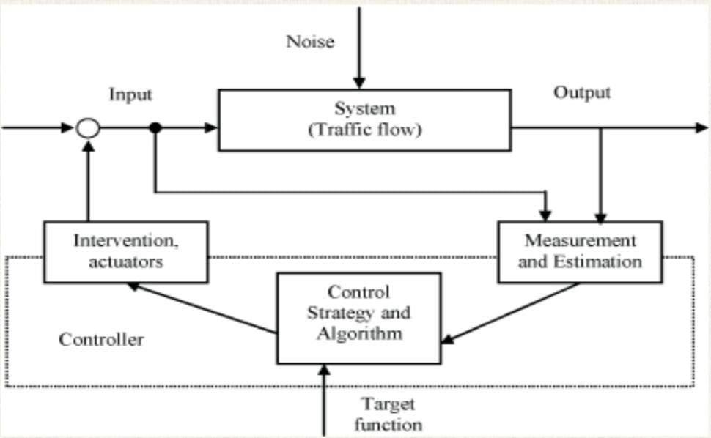
ARCHITECTURE OF THE PROPOSED SYSTEM
SMART TRAFFIC MANAGEMENT
NOISE
INPUT
OUTPUT
SYSTEM
(TRAFFIC FLOW)
INTERVENTION ,
ACTUATORS
MEASUREMENT AND ESTIMATIION
CONTROL
STRATEGY AND ALGORITHM
CONTROLLER
TARGET
FUNCTION

Slide 8
LIST OF MODULES
Cameras
This collect real-time data on traffic conditions such as vehicle count, speed, and congestion levels.CCTV Cameras capture video footage for monitoring and analyzing traffic behavior and incidents.
User Interface (UI)
Allows traffic control operators to monitor traffic, view real-time data, and override or adjust the system if necessary.
Traffic Signal Controller
Manages the actual operation of traffic signals at intersections based on real-time data.
Central Control Unit (CCU)
The brain of the traffic management system, responsible for making decisions based on real-time data from cameras.
Data Collection and Processing
Collect, preprocess, and store data from various sensors in real-time.

Slide 9
MERITS
1.Reduced Traffic Congestion:
Dynamically adjusts traffic signals based on real-time data, optimizing vehicle flow and minimizing congestion at intersections.
2. Improved Road Safety:
Detects accidents and hazardous situations promptly, allowing for quick responses and reducing the likelihood of secondary collisions.
3. Lower Environmental Impact:
Reduces fuel consumption and emissions by minimizing idle times and enhancing the efficiency of traffic flow.
4. Time Savings:
Shortens travel times by optimizing traffic signal timings and providing alternate routes during peak congestion periods.
5. Better Emergency Response:
Facilitates faster movement of emergency vehicles by prioritizing their routes and clearing traffic in real time.
6. Data-Driven Decision-Making:
Provides authorities with actionable insights from collected data, enabling better traffic planning and infrastructure development

Slide 10
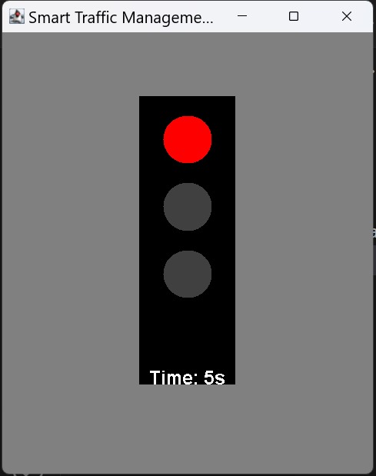
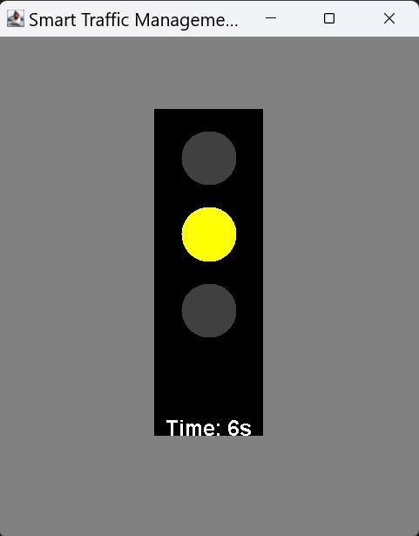
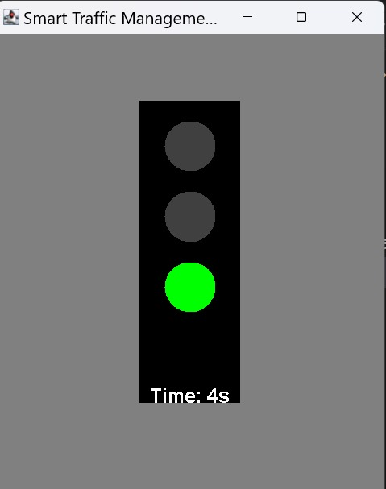
RESULTS AND DISCUSSION

Slide 11
QUERIES ?

